Slide 1
New Dashboard Features for Analysts
May 6, 2025

Slide 2
Who am I?
Andrew Card, lead analytics consultant at Relevant
Background in patient safety
3 years with Relevant

Slide 3
Agenda
Defining Relevant reports and dashboards
New features
Demos
UDS comparisons
Outreach
Operations
Building a dashboard
Vega-Lite tips and tricks
Q/A

Slide 4
Questions for you…
Are you currently building dashboards in Relevant?
Do you use external dashboarding tools like Tableau or PowerBI?
What types of dashboards do you see a need for?

Slide 5
What is a report? What is a dashboard?
At the most granular level, a report “view” is a single table or visualization from a single query.
A report is limited to one query, but it can have multiple report views (e.g., a table, a bar chart, and a pivot table)
Dashboards allow for a collection of report views across multiple reports, typically centered around a theme or audience (e.g., operations, finance, provider performance, etc.)

Slide 6
Standard vs library vs custom reports
Standard reports:
New feature in Relevant! We have 35 standard reports already
Already in your Relevant with statuses of “Published (hidden)”
Auto-updated by Relevant and identical across health centers. Not customizable
Library reports:
Need to be imported from the Relevant library
Created using standard Relevant logic but customizable
Once imported, Relevant can’t make universal updates
Custom reports:
Custom built to meet your specific reporting needs
Not maintained by Relevant

Slide 7
Report statuses
Can add to dashboards
Cannot add to dashboards
Published:
Validated and used by your organization
Report viewers can see published reports in the report list
Published (hidden):
New!
Published but not displayed in the reports list for report viewers
Keeps the reports list uncluttered, especially for reports created specifically for Dashboards
Standard reports are typically published as hidden. This can be updated by editing the report
Draft:
Reports that are still being created/validated
Report viewers cannot see them in the reports list, but can access via direct link
Archived:
Reports that are retired or are no longer needed
Not visible to report viewers in the Reports list

Slide 8
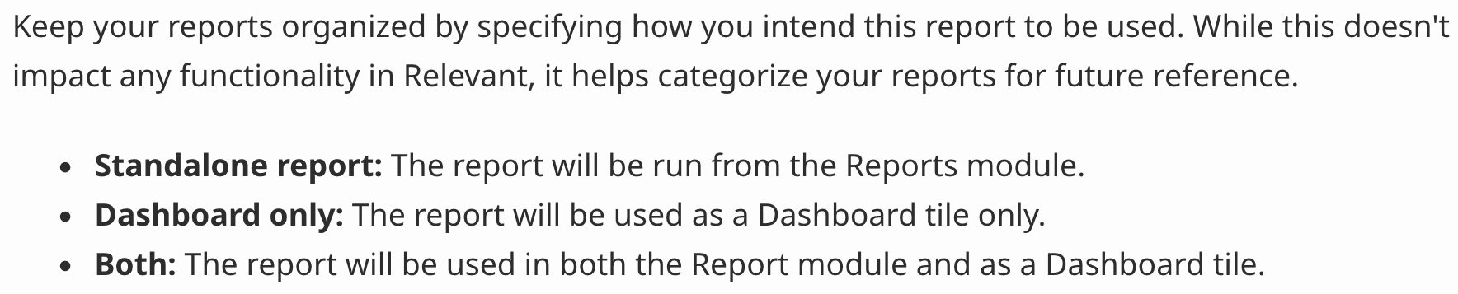
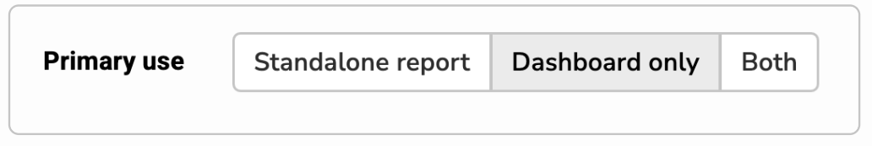
Primary use

Slide 9
Product changes
Ability to rename dashboard tiles
Add quality measure tiles to dashboards
Dashboard parameters auto-select tile parameters
Note: Parameters must have the same name to link automatically
Dashboard links include filter selections

Slide 10
Dashboard Demos:
UDS Snapshot Dashboard
Outreach Dashboard
Operations Dashboard
Building a dashboard

Slide 11
A note on end user engagement
Involving end users in development leads to engaged users!
Suggested development process:
Start with a dashboard goals meeting
Do a dashboard draft review
Have a dashboard finalization meeting
Check in on usage/usability after 6 weeks
Ways to track dashboard usage is under development

Slide 12
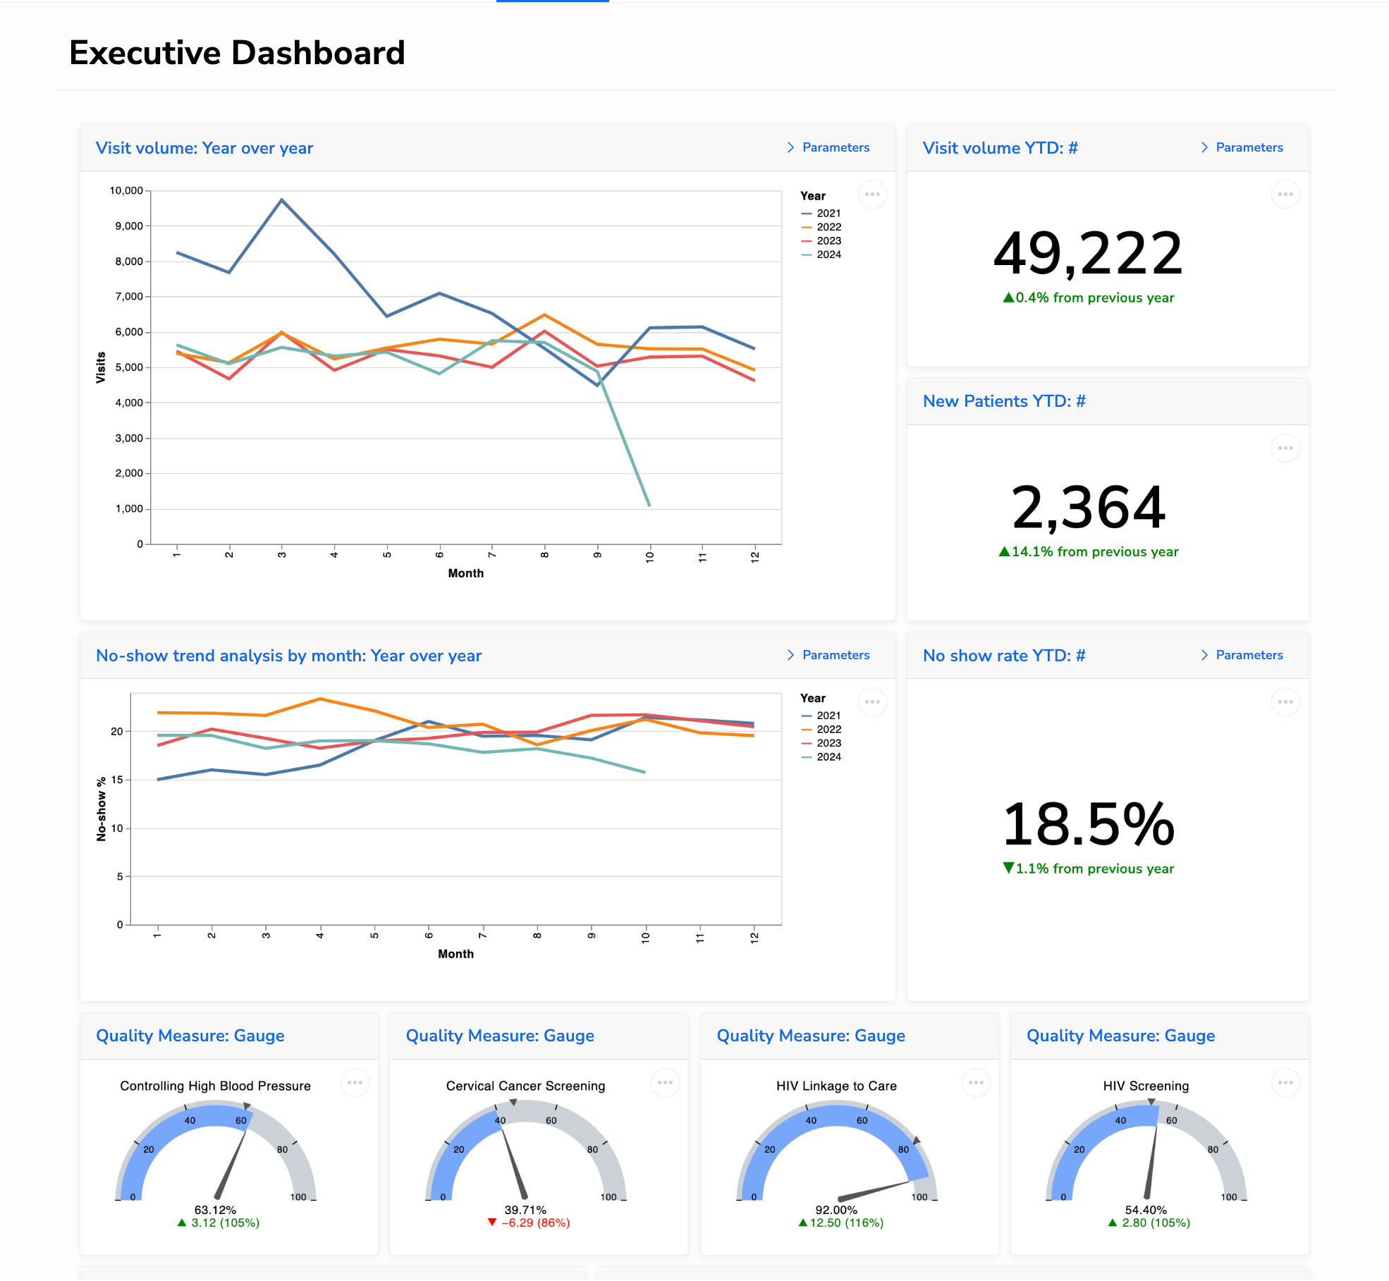
Audience focused dashboards
Focus on simplicity & big numbers
Include benchmarks and comparisons
Include links to more specific topical dashboards
Common examples:
Providers
Executive
QI leads
Finance

Slide 13
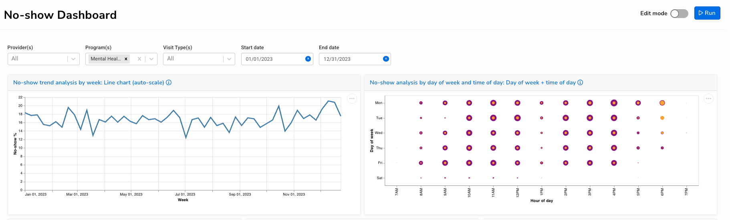
Topic focused dashboards
Deep dive into one focus area
Consider multiple audiences
Allow slicing same data by different dimensions
Common examples:
No shows
Care gaps
Outreach
Health equity
UDS comparison

Slide 14
Make dashboards performant
Do most aggregation and filtering in SQL
Views are calculated on the “front end”
If something is particularly slow, consider moving it to the pipeline
Allows for complicated calcs to be precomputed each night
The right place may be a transformer, measure, or custom alert

Slide 15
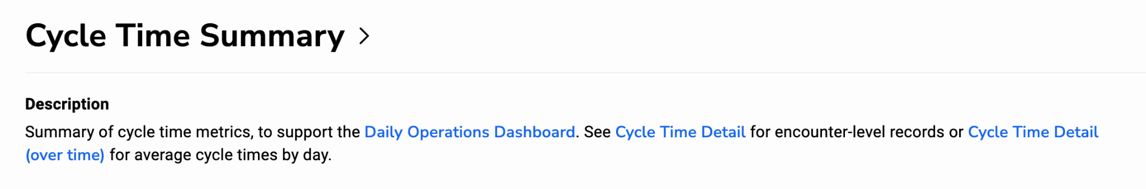
Link to line-level details
Provide a link to a line-level validation report

Slide 16
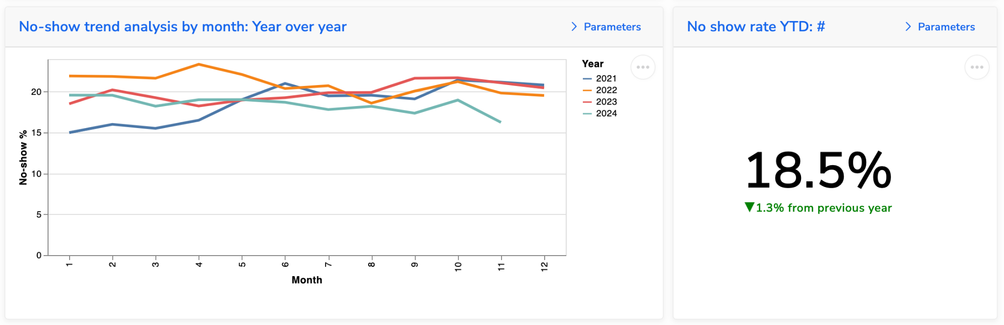
Provide context and benchmarks
Looking at numbers by themselves is often not very interesting. What are we comparing this to?
For QMs: show the target and potentially the org average.
For operational metrics: show comparisons to previous time periods.
Supplement “big numbers” with trend charts

Slide 17
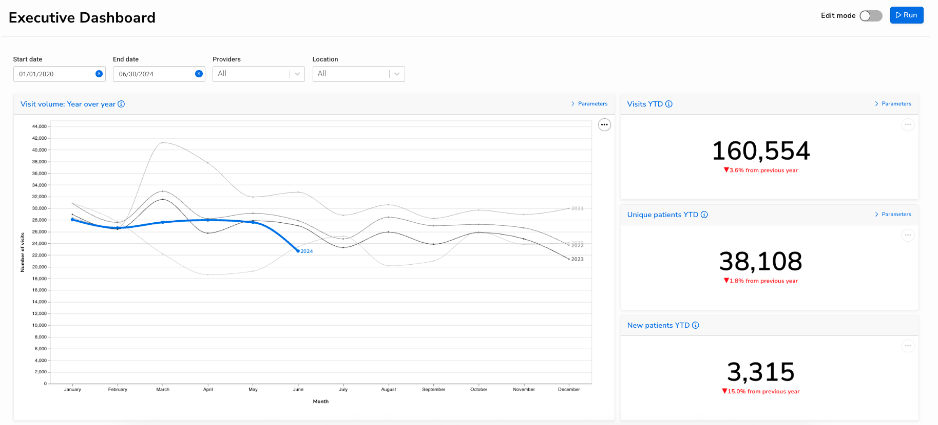
Treat rows as thematic groups

Slide 18
Dashboards should work without parameter adjustment
Parameters should have default values that produce interesting results
Users may be discouraged from exploring a dashboard if it immediately displays few results (or too many)
Use SQL to filter results down to a meaningful time period (e.g., year to date) unless it’s crucial for the user to be able to adjust the time period

Slide 19
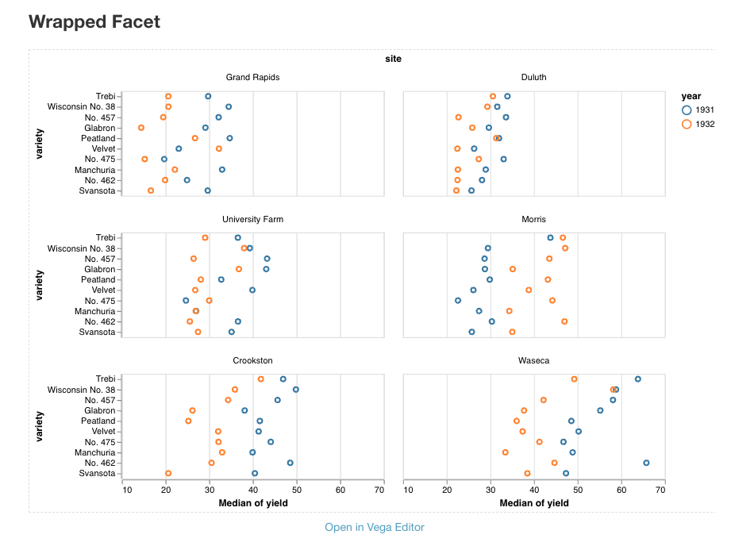
Vega-Lite facets are often a mistake
They can be cool but they are often difficult to lay out in a way that works well with a responsive dashboard

Slide 20
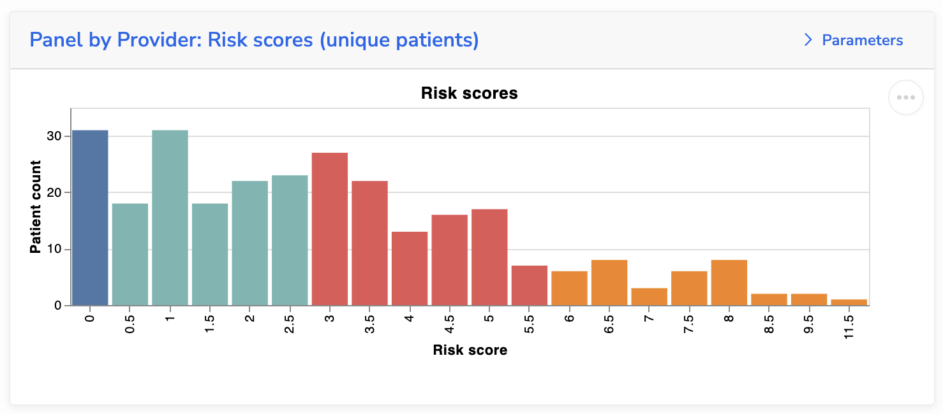
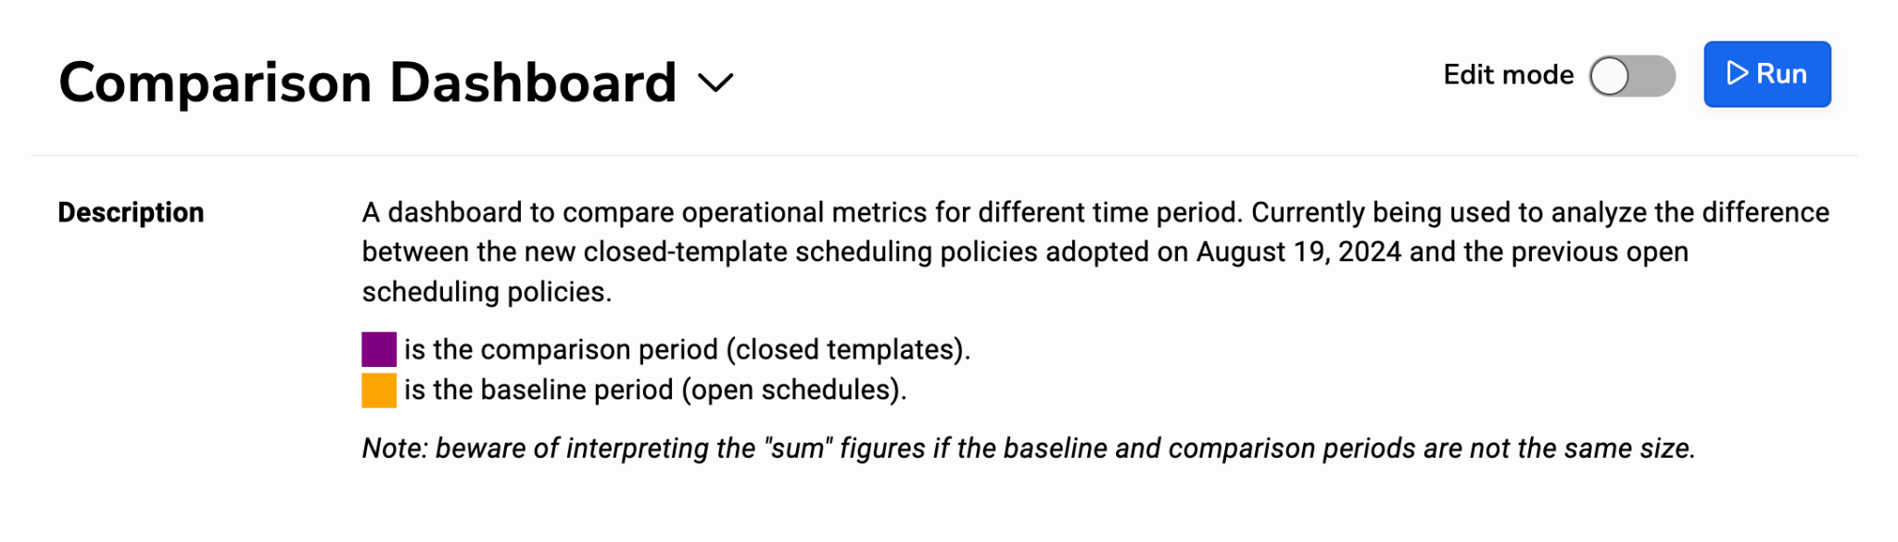
Make dashboards as clear as possible
Don’t include titles in visualizations that will be dashboard tiles
Use the descriptions and use markdown
❌

Slide 21
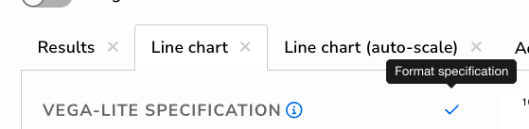
Vega-Lite tips
Use AI to help you get started and for repetitive changes
Claude and ChatGPT are both helpful! Try both when one is stuck
Specify available columns when asking LLMs
Copy from existing code
Vega-Lite’s gallery
Relevant standard reports
Use Vega-Lite format specification to auto format:

Slide 22
Pros and cons of Vega-Lite
Pros
Cons
Extremely powerful and flexible (as powerful as tools like Tableau)
Well represented in LLM training data sets
Free and integratable into Relevant
Rich example library
Not very user friendly
Requires coding (no point and click)
Most analysts need example code or AI to get started
No drill-through
Sometimes not ideal for tables

Slide 23
Vega-Lite Demo
Copying Vega-Lite code
Using AI to build tables in Vega-Lite

Slide 24
Questions for you…
What standard reports and dashboards would you like to see Relevant develop next?
What product enhancements would make reporting easier?

Slide 25
support@relevant.healthcare

