Slide 1
Effective Use of Populations, Risk Models, and Care Gaps
2025 Aliados Health Analytics Academy Presentation
By Benjamin Fouts MPH, Data Analyst, Aliados Health
and Katya Blitsman, Senior Analytics Consultant, Relevant Healthcare
May 6, 2025
Aliados Health Analytics Academy

Slide 2
Agenda
Relevant Grouping Tools Within the Context of a Broader QA/QI System
Populations
Care Gaps
Risk Models
Use of Populations, Care Gaps and Risk Models in Relevant Data Display and Analysis Tools

Slide 3
Introduction
This presentation is a basic overview of three tools within the context of normal health center Quality Performance work.
It is not a complete instruction manual. For more details, please see the Relevant Help files. To keep consistent language, some of the slides contain wording from the help files.
Download this slideshow and use it as a reference later
We will be focusing on clinical data, not financial data
Assumed basic familiarity of the data visualization tools covered in the “Back to Basics” session this morning

Slide 4
Relevant Grouping Tools Within the Context of a Broader QA/QI System
(Quality Assurance / Quality Improvement System)

Slide 5
Software Tools for QA vs QI
Quality Assurance (QA) software tools focus on ensuring compliance with established standards
Quality Improvement (QI) software tools focus on identifying opportunities for improvement and implementing strategies to improve patient outcomes
Notes:
Reference: ZenBit Tech (https://zenbit.tech/blog/difference-quality-assurance-vs-quality-improvement/#:~:text=Well%2C%20they%20are%20two%20crucial,for%20growth%20and%20increase%20efficiency.)

Slide 6
The Data-Driven QA/QI Process at a Health Center
1. Track progress toward goals and communicate results to clinic leaders, funders and the community
Example: reporting UDS, QIP and PHMI data
Example: reporting to clinical leadership and the board of directors
2. Gain new insights about trends over time and identify gaps in care
Example: Investigation of measures that appear lower than benchmarks or goals
Example: Comparing results by sub-group of patients (i.e., by patient attributes, service-provider attributes, etc.)
3. Make informed and evidence-based decisions about how and where to spend time, effort and resources, then measure the impact of the change
Example: Continual performance improvement
Example: PDSA cycles (and other similar approaches)

Slide 7
Focus of this Presentation
Describe how three Relevant grouping tools can used to:
Populations, Care Gaps and Risk Models allow you to group patients of interest according to defined characteristics
2. Gain new insights about trends over time and identify gaps in care
From last slide
3. Make informed and evidence-based decisions about how and where to spend time, effort and resources, then measure the impact of the change

Slide 8
Examples of Grouping Patients of Interest in Relevant
It is important that standardized groups of patients be recognized throughout the software for various purposes
Three grouping tools in Relevant:
Population – a group of patients with defined characteristics
Care Gap – a group of patients who need a particular service
Risk Model – groups patients into risk levels to help optimize the quality of care that they receive

Slide 9
Populations
A group of patients with defined characteristics

Slide 10
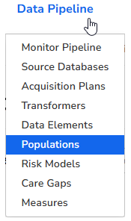
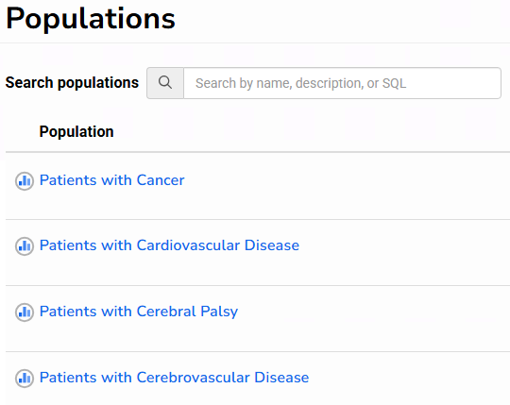
Overview of Populations
A population is a group of patients who share a defined characteristic (or set of characteristics)
There are many standard/pre-set populations available
In the app:

Slide 11
Overview of Populations
Custom populations can also be created with SQL (programming language)
In the background, only the internal patient_id is displayed, and not any other characteristics or information. Therefore, the population is simply a list of patients who meet certain criteria
The population can then be combined with concepts such as “having a medical visit in the past year” or “between 12 and 18 years of age” in other parts of Relevant

Slide 12

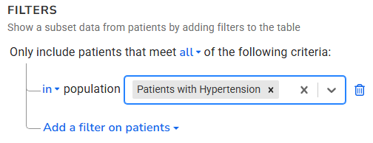
Example of Using a Population in Data Explorer
Populations are a way that you can standardize a group of patients within Relevant. It also saves time by not having to “re-invent the wheel” on different screens in Relevant
Make a list of patients with hypertension who have not had a blood pressure in the past 6 months
All of these queries start with the same definition of patients with hypertension. Thus, the filter is the same everywhere
Make a list of patients with hypertension and last blood pressure over 140/90
Make a list of patients with hypertension and diabetes, by primary care provider

Slide 13
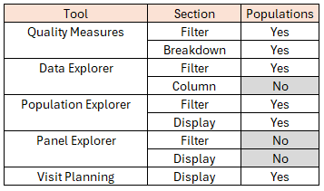
Using Populations in Relevant Tools
More information about this later in the presentation

Slide 14
Care Gaps
A group of patients who need a particular service

Slide 15
Patient-Specific Function of Care Gaps
Customized alerts that are useful in the Visit Planning section of Relevant
Display recommended interventions and tasks for patients based on their EHR data
Target specific groups of patients who need specific services
Time-bound in that the service may be needed now (is overdue) or a specified time in the future
Care Gaps should be based on important clinical guidelines or numerators of the Quality Measures
There are standard Care Gaps and a health center can create its own

Slide 16
Components of a Care Gap
Intervention – customized text for the recommended intervention that displays in Visit Planning for all patients.
Detail - lists specific information from the EHR about the patient
Upcoming behavior - You can choose to calculate care gaps prospectively, so that patients who will have a care gap become due within the chosen time frame will have the alert show up.

Slide 17
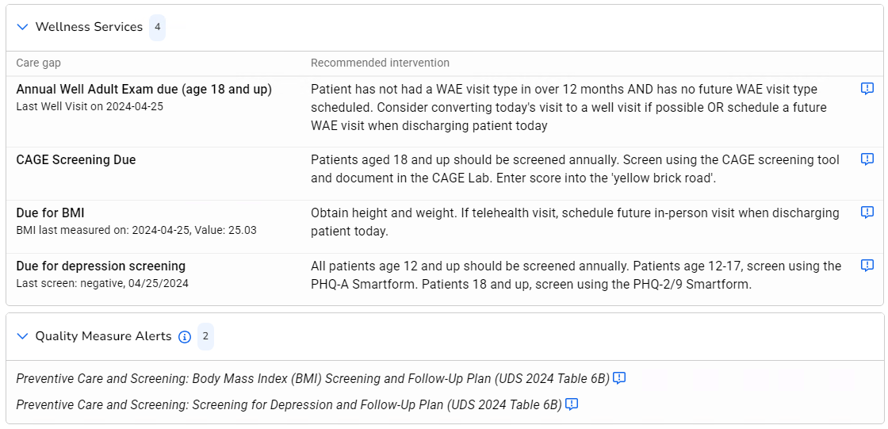
Care Gap Display in Visit Planning
Care Gaps are placed in customizable groups (e.g., “Wellness Services”)
The “Detail” is in the text below the Care Gap name

Slide 18
Example for the Quality Measure “Preventive Care and Screening: Screening for Depression and Follow-Up Plan (UDS)”
Desired outcome from Quality Measure: Patients screened for depression within the measurement period using an age-appropriate standardized depression screening tool
Care Gap Population: Quality Measure denominator patients (age 12 and older without standard measure exclusions) without a depression screen in the past year

Slide 19
Example for the Quality Measure “Preventive Care and Screening: Screening for Depression and Follow-Up Plan (UDS)”
Intervention text in Visit Planning displays for all Care Gap patients. Example: “All patients age 12 and up should be screened annually. Patients age 12-17, screen using the PHQ-A Smartform. Patients 18 and up, screen using the PHQ-2/9 Smartform.”
Detail text is patient-specific and particular to the subject that is being considered in the Care Gap. Examples:
If an old screen exists in the EHR for the patient: "Last screen: Negative, 3/3/2022"
If no screen exists in the EHR for the patient: "Last screen: 'Never screened"

Slide 20
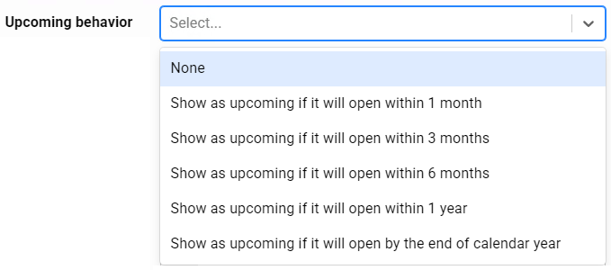
Upcoming Behavior
You can choose to display the care gap for patients who have it due now (that is, on the day it is run) or have it due in the near future
Depression example: Displays Care gap for patients with depression screen due today -- AND (optional) --
From the Care Gap configuration screen

Slide 21
Upcoming Behavior
Useful for services that can be scheduled now (while the patient is in the clinic) for a future date
Better examples:
A cervical cancer screening that should be scheduled as a separate appointment
A mammogram performed by an outside provider who has available appointments booked weeks out
How you deal with upcoming behavior depends on the workflow you have around dealing with the service

Slide 22

Other Care Gap Ideas
Relevant comes with a number of standard Care Gaps, many tied to standard Quality Measures
You can create your own Care Gaps (using SQL) or copy and modify a standard one
You can choose which Care Gaps to enable (so they refresh with current data at night) and which ones to show in Visit Planning
From the Care Gap configuration screen

Slide 23
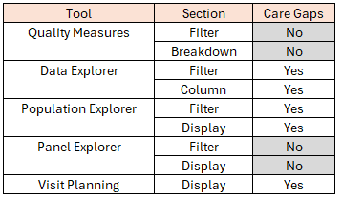
Using Care Gaps in Relevant Tools
More information about this later in the presentation

Slide 24
Risk Models
Models that group patients into risk levels to help optimize the quality of care that they receive

Slide 25
Risk Model Definitions
The Risk Models Module in Relevant allows users to create and manage multiple risk stratification models
A Risk Model uses various patient attributes to create a Risk Score. The patient’s Risk Level depends on the Risk Score
Risk Score and Level for each enabled model are displayed throughout Relevant and can be used as filters
Higher or lower risk categories can inform decisions on care, lead to case management activities, or initiate certain interventions

Slide 26
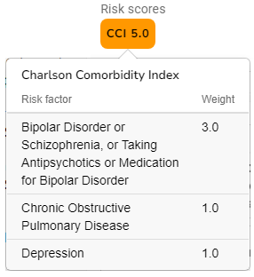
Risk Score
In Relevant, a bubble is displayed with the Risk Model's short name (e.g. CCI), the patient's risk score to the tenths place, and a color corresponding to the model's risk level configuration
Hovering over the bubble will bring up risk factor details if the model has been configured to do so
The score weights, risk levels, and colors are all customizable

Slide 27
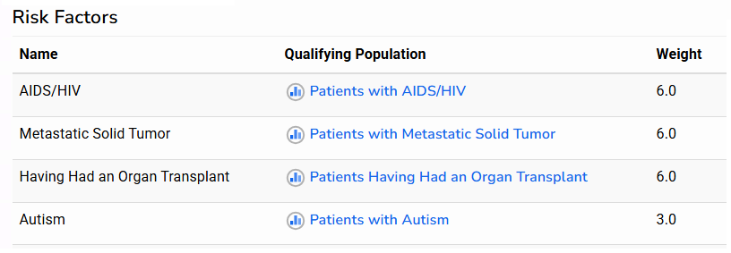
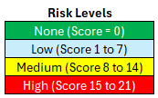
Example of a Risk Calculation
Patient #1 has the following diagnoses:
HIV/AIDS
Organ Transplant
Autism
Risk Score:
6 + 6 + 3 = 15
Risk Level = High
Patient #2 has the following diagnoses:
Metastatic Solid Tumor
Autism
Risk Score:
6 + 3 = 9
Risk Level = Medium

Slide 28
Standard Risk Models in Relevant
There are three standard models that exist in Relevant. These models have been adopted from academic sources and have validated results
Health centers can choose to enable and use them, or not
Health centers can also create their own models. There is flexibility on how weights are assigned and the number and range of risk levels

Slide 29
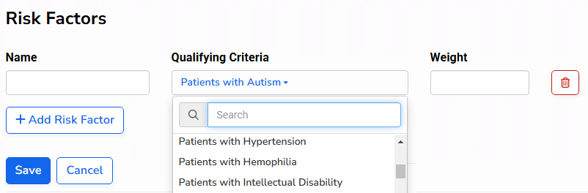
Custom Risk Models: Two Design Approaches
Risk factor approach: add pre-programmed risk factors from a large drop-down list and add weights to each factor. The total risk Score is the summary of all the individual weights
SQL approach: program it in SQL to produce an overall Risk Score (note that risk factor breakdown is not available in this case, just the final score and level)
From the design screen

Slide 30
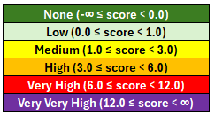
Charlson Comorbidity Index
(Short Name in Relevant is CCI)
Description: An enhanced version of the Charlson Comorbidity Index (CCI), a risk stratification model designed to attribute risk scores to patients based on various chronic conditions. The enhanced CCI has been validated to predict all-cause mortality and total cost of care.
36 risk factors with weights from 1.0 to 6.0. All risk factors are diagnoses (co-morbidities)
Risk Levels (example):
Risk level ranges and colors are customizable

Slide 31

10-Year ASCVD Risk Score
(Short Name in Relevant is ASCVD)
Description: Based on the American College of Cardiology’s ASCVD Risk Calculator
SQL approach used in its design because there is a complicated risk calculation that depends on age, lab scores, co-morbidities, etc.
Risk Levels (example):
Risk level ranges and colors are customizable

Slide 32

COVID-19 Severity Risk Index
(Short Name in Relevant is COVID)
A count of comorbidity conditions that contribute to the risk of developing severe disease as a result of a COVID-19 infection, according to current WHO and CDC guidance.
Risk Levels (example):
Risk level ranges and colors are customizable

Slide 33
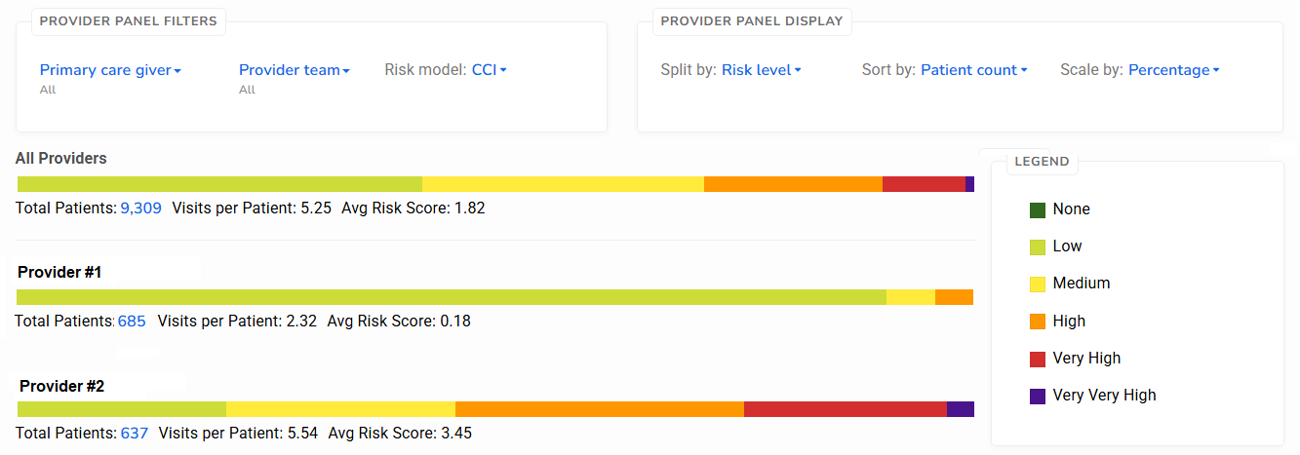
Example of Using Risk Level in Panel Explorer

Slide 34
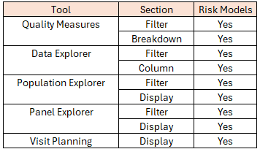
Using Risk Models in Relevant Tools
More information about this later in the presentation

Slide 35
Use of Populations, Care Gaps and Risk Models in Relevant Data Display and Analysis Tools

Slide 36
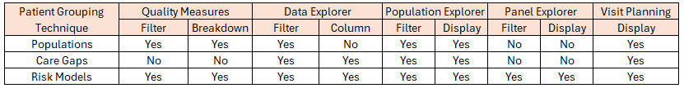
Summary of Grouping Technique Availability Within the Relevant Data Visualization Tools
A summary of the tables at the end of the three previous sections
Also refer to the slides from the presentation “Back to Basics: Using Relevant To View and Interpret Data” earlier today

Slide 37
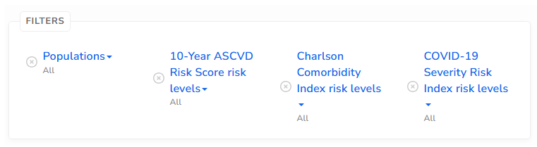
Filters in Quality Measures

Slide 38
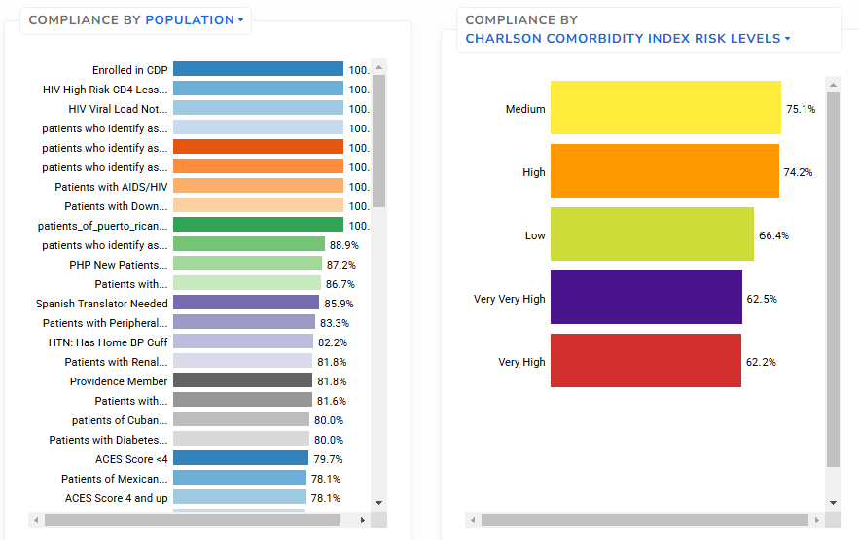
Breakdown Display in Quality Measures

Slide 39
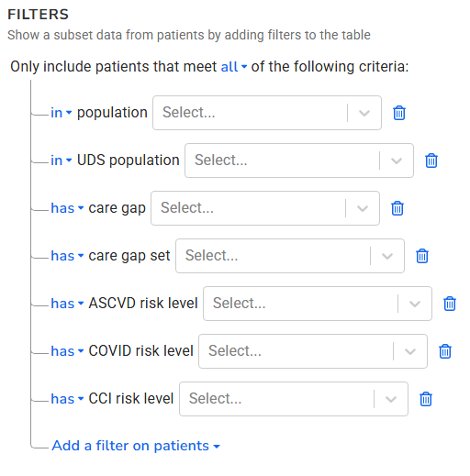
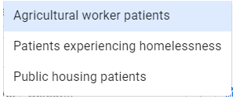
Filters in Data Explorer
Each features a drop-down list of standard and custom elements within the filter
Technically not the same as the “populations” we have been discussing. These are the standard UDS categories from Table 4

Slide 40
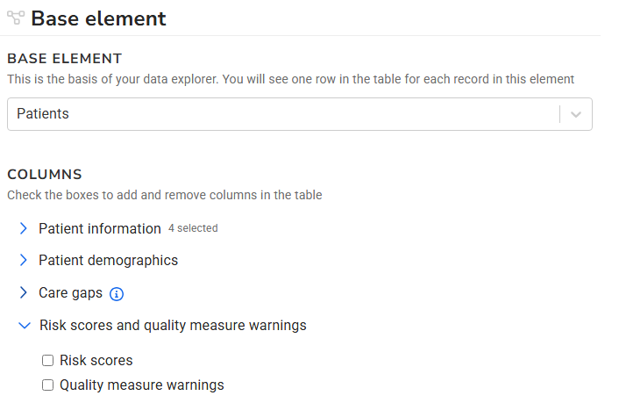
Columns in Data Explorer
Display Yes/No plus Care Gap Description
Display abbreviation and score

Slide 41
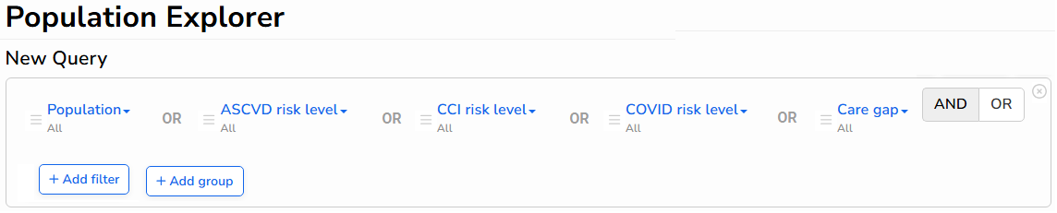
Filters on Population Explorer

Slide 42
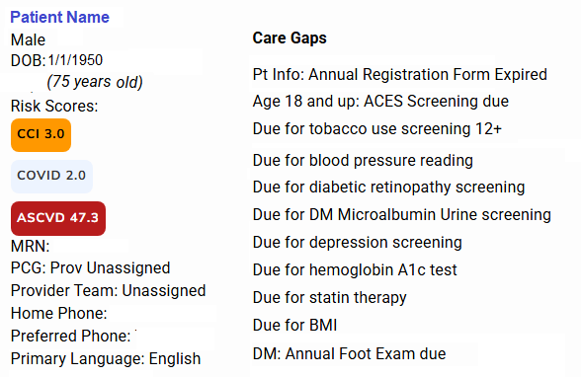
Display in Population Explorer
Population Explorer shows basic patient identifiers along with the Risk Models and Care Gaps for individuals

Slide 43
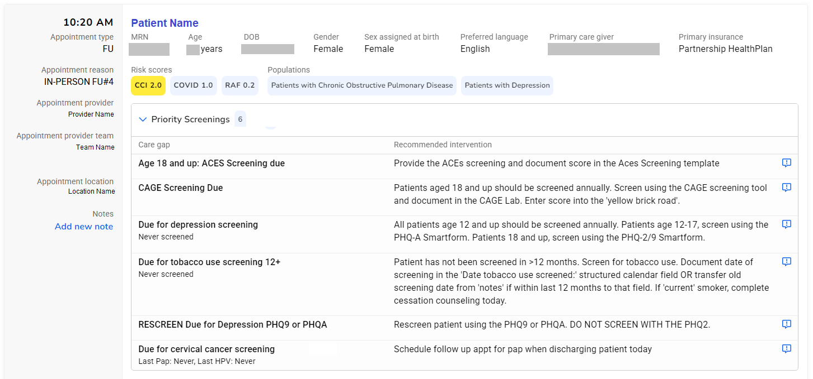
Display in Visit Planning

Slide 44
Relevant Demonstration

Slide 45
Questions?

