Slide 1
Back to Basics: Using Relevant To View and Interpret Data
2025 Aliados Health Analytics Academy Presentation
By Benjamin Fouts MPH, Data Analyst, Aliados Health
May 6, 2025
Aliados Health Analytics Academy

Slide 2
Agenda
The Context of Quality Management
Relevant Tools to Visualize Summary Data
A. Quality Measures
B. Dashboards
C. Reports
D. Visit Calendar
Relevant Tools to Display Data for Individual Patients
E. Reports (#2)
F. Data Explorer
G. Population Explorer

Slide 3
Introduction
This presentation focuses on data visualization and quality monitoring
It is a basic overview within the context of Quality Performance work. It is not a complete instruction manual. For more details, please see the Relevant Help files. To keep consistent language, some of the slides contain wording from the help files.
We will be focusing on clinical data, not financial data

Slide 4
The Context of Quality Management
Relevant Data Visualization Tools Within a Broader Framework

Slide 5
Focus on Quality
The quality of health services at the primary care level is defined as the “degree to which health services for individuals and populations increase the likelihood of desired health outcomes.” -- World Health Organization
The health center provides health services to patients and records data in the Electronic Health Record (EHR). The health information system (i.e., Relevant) pulls data from the EHR, summarizes it, and measures progress toward the desired health outcomes.
Notes:
Reference: WHO. Quality of care [Internet]. World Health Organisation. 2022 [cited 2022 Apr 4]. Available from: https://www.who.int/health-topics/quality-of-care#tab=tab_1

Slide 6
Components of Project Quality Management
Quality Planning - shaping clear goals for the project (like defining clinical guidelines, objectives for provider/staff trainings, and outcome targets).
Quality Assessment - using tests, metrics, checklists, etc. to demonstrate to stakeholders the project is running as it should.
Quality Control - identifying and implementing solutions to problems or shortcomings in reaching goals.
Notes:
Reference: Project Quality Management: A Guide to Processes and Techniques (Adobe Communications Team, Adobe for Business, 2022)

Slide 7
Model for Continual Performance Improvement
What are we trying to accomplish? This question establishes the aim for improvement efforts and ensures that collected data is related to quality goals.
How will we know that a change is an improvement? This question sets up the criteria for determining when change results in sustainable improvement.
What changes can we make that will result in improvement? This question leads to the PDSA cycle, which tests small scale changes, or interventions, to see their effect on outcomes.
Notes:
Reference: A Guide to Applying Quality Improvement to Healthcare: Five Principles, by Lloyd Provost. Posted here- (https://www.healthcatalyst.com/learn/insights/quality-improvement-healthcare-5-guiding-principles)

Slide 8
National health priorities,
local health priorities,
funder health priorities
Training staff on patient care and EHR data entry
What are we trying to accomplish?
Clinical guidelines,
Standards of care
Health information and data analysis systems
Investigation into results that do not meet standards
How will we know that a change is an improvement?
Quality measures and core indicators
Monitoring the effectiveness of quality interventions
What changes can we make that will result in improvement?
Develop improvement methods and interventions
Quality improvement cycles
Feedback to staff and training on patient care and EHR data entry

Slide 9
Software Tools for QA vs QI
Quality Assurance (QA) software tools focus on ensuring compliance with established standards
Quality Improvement (QI) software tools focus on identifying opportunities for improvement and implementing strategies to improve patient outcomes
Notes:
Reference: ZenBit Tech (https://zenbit.tech/blog/difference-quality-assurance-vs-quality-improvement/#:~:text=Well%2C%20they%20are%20two%20crucial,for%20growth%20and%20increase%20efficiency.)

Slide 10
The Data-Driven QA/QI Process at a Health Center
1. Track progress toward goals and communicate results to clinic leaders, funders and the community
Example: reporting UDS, QIP and PHMI data
Example: reporting to clinical leadership and the board of directors
2. Gain new insights about trends over time and identify gaps in care
Example: Investigation of measures that appear lower than benchmarks or goals
Example: Comparing results by sub-group of patients (i.e., by patient attributes, service-provider attributes, etc.)
3. Make informed and evidence-based decisions about how and where to spend time, effort and resources, then measure the impact of the change
Example: Continual performance improvement
Example: PDSA cycles (and other similar approaches)

Slide 11
Quality Assurance (QA): Relevant Tools to Visualize Summary Data
Covering Four Tools

Slide 12
Relevant Tools to Visualize Summary Data
QA/QI process steps from a previous slide
We will overview the Relevant tools as they can be used in these process steps.
We will not dive deeply into the configuration details or cover the technical aspects of coding. Please refer to the Relevant Help files!
Download this slideshow and use it as a reference later
1. Track progress toward goals and communicate results to clinic leaders, funders and the community
2. Gain new insights about trends over time and identify gaps in care

Slide 13
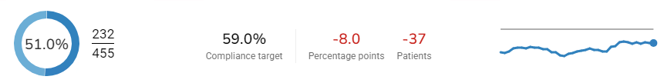
Part A. Quality Measures
Relevant has several standard UDS and QIP Quality Measures
Health centers can also create their own
What are we trying to accomplish? Add Compliance Targets to measures so that you can see where you stand relative to them. From the Quality Measures Overview Screen in Relevant:
Measure goal
Current status
Difference between the current status and goal
The data trend over time

Slide 14
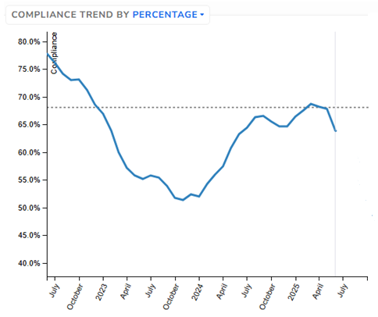

Viewing Measure Results
Measures display a rolling measurement period, typically a series of year-long measurement periods ending the last day of the month
You can see the current measurement period result or past results
The graph shows the trend over time (each data point is one measurement period ending at the end of the month)
On measures overview screen On specific measure screen

Slide 15
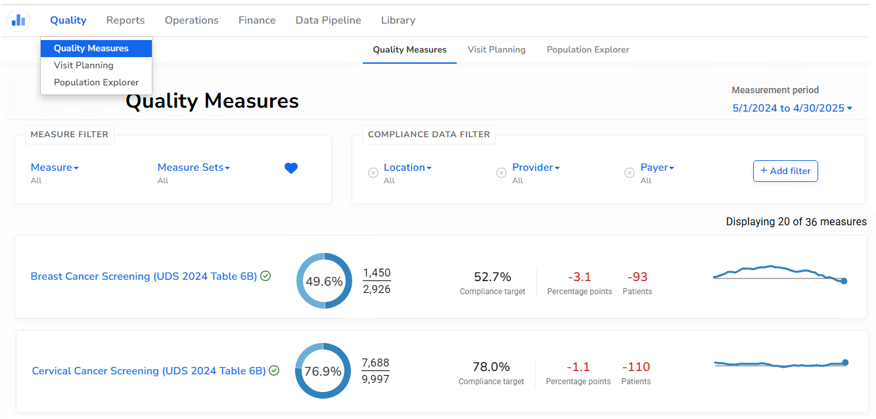
Quality Measures Overview Screen
Measurement period options
Available Data Filters

Slide 16
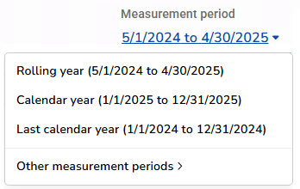
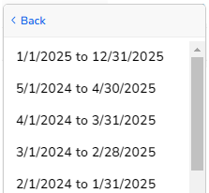
Measurement Period Options
Latest period is the default (note the measurement period might not be finished yet today, so it is not final data)
The denominator and numerator include patients who meet the definitions for the year so far.
The last UDS period
List of many individual measurement periods

Slide 17
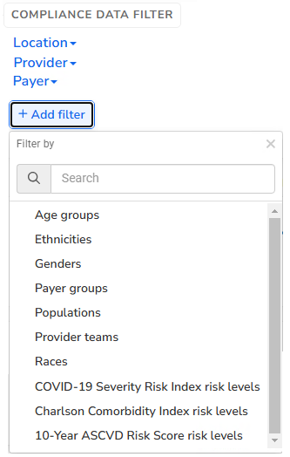
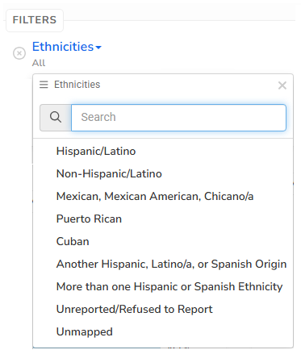
Available Data Filters
Default (most common) filters
Other filters can be added
Once added, you can choose one or more options in the drop-down list

Slide 18
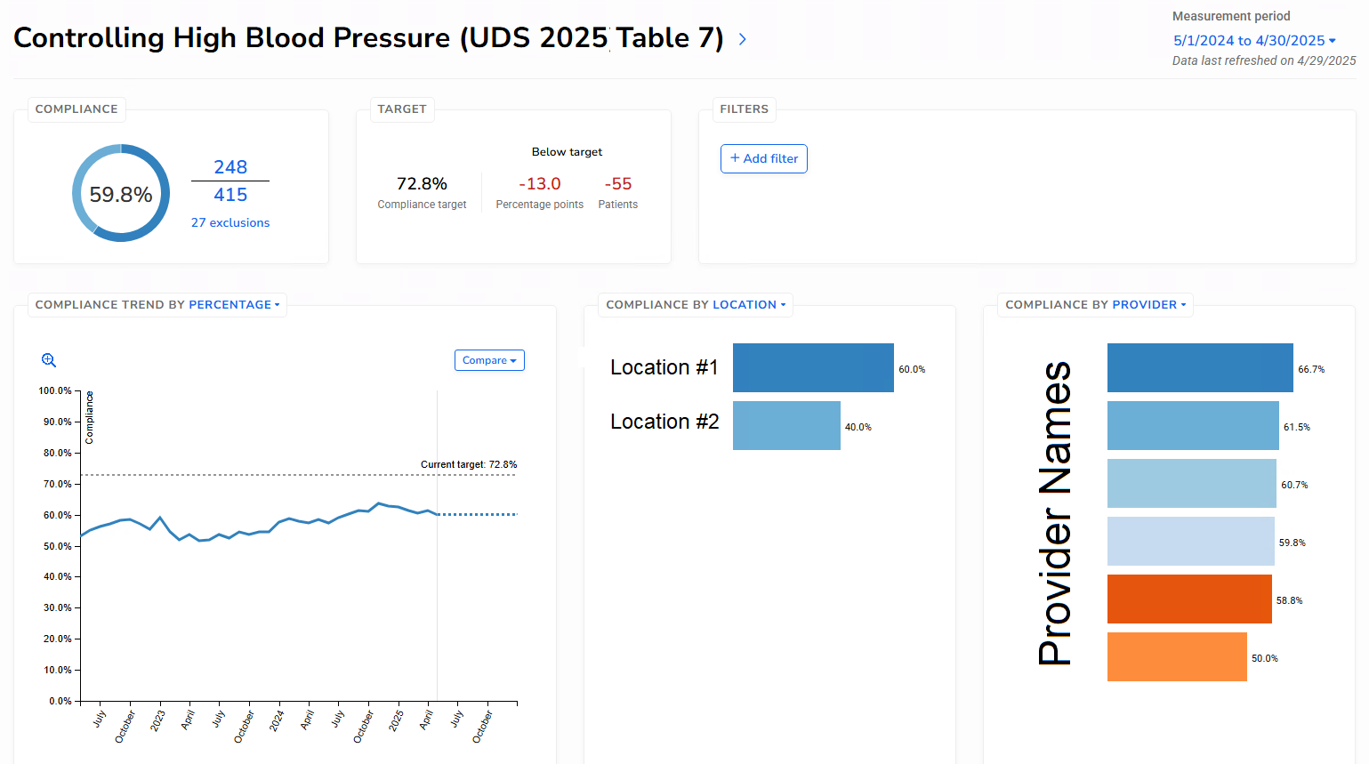
Specific Measure Screen
Same filters available on this screen
Display Breakdown (#1)
Display Breakdown (#2)

Slide 19
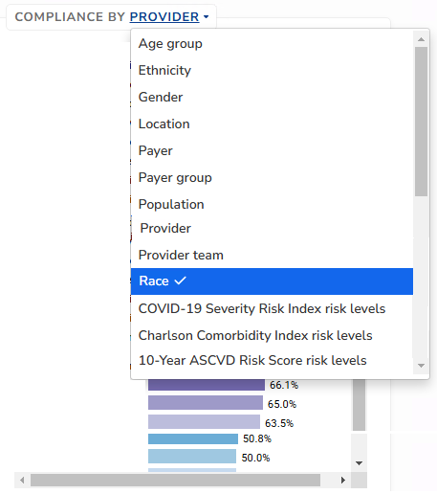
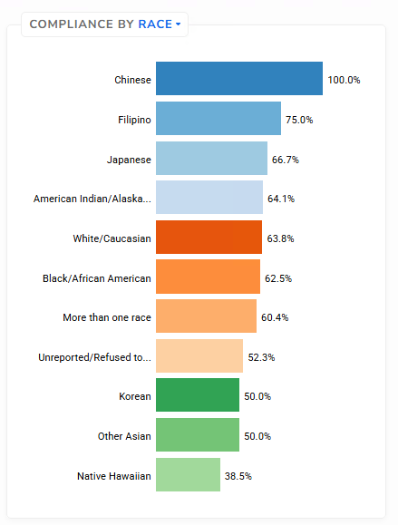
Display Chart Breakdown
Can be used as a comparison itself.
Alternately, click one or more colored bars to filter the data to the Compliance Trend Graph

Slide 20
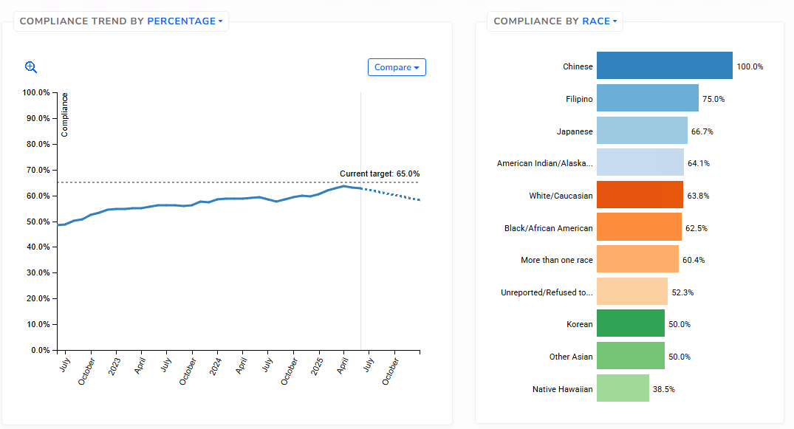
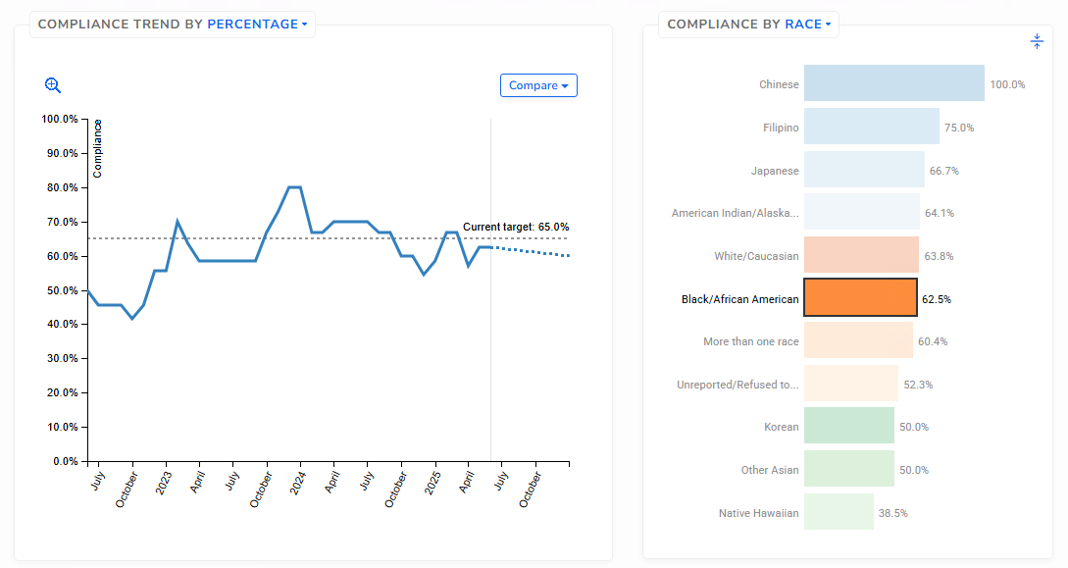
Trend is for all patients by default
Click on one or more colored bars
For example, “Black/African American”
Trend is now for the selected race(s)

Slide 21
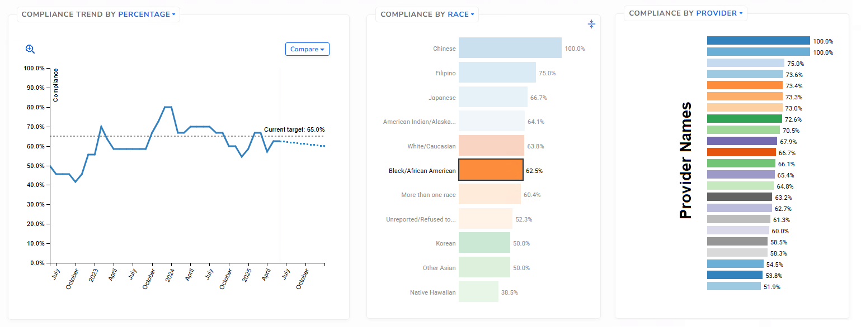
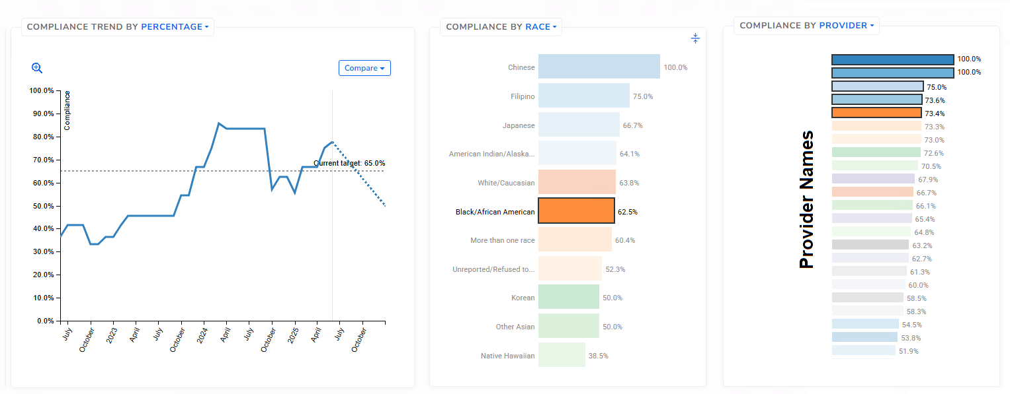
Note that there are two break-down graphs and both are tied to each other
In the second graph, these are the providers who have at least one Black/African American patient as specified in the first graph
One or more colored bars on the second (provider) graph can also be selected… which will further change the Compliance Trend graph

Slide 22
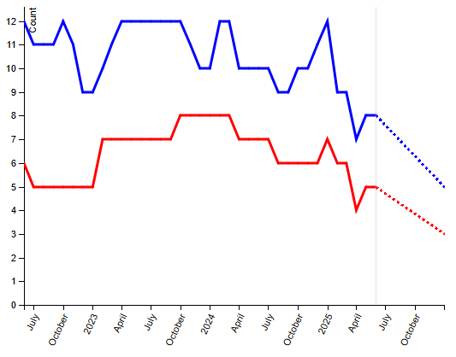
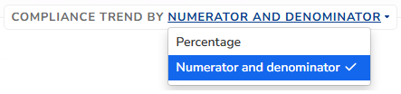
By default, percentages are displayed on the breakdown and the compliance trend graph. These do not tell you how many patients are in each category.
Option to switch to numbers for the Numerator and Denominator on the Compliance trend graph

Slide 23
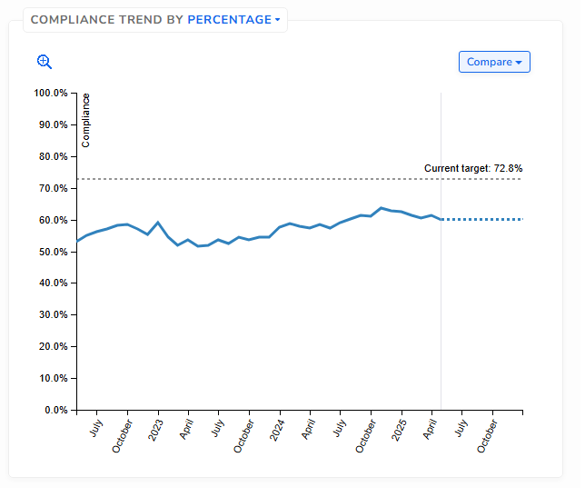
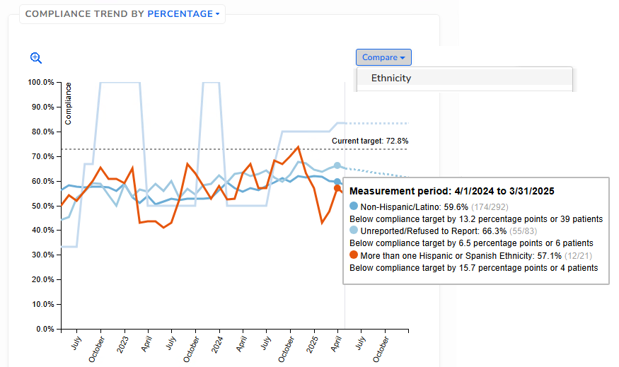
Compliance Trend Graph Comparison
“Compare” options are the same as the standard filters we saw on a previous slide
Hovering over the graph displays detailed data. Graph lines can also be selected

Slide 24
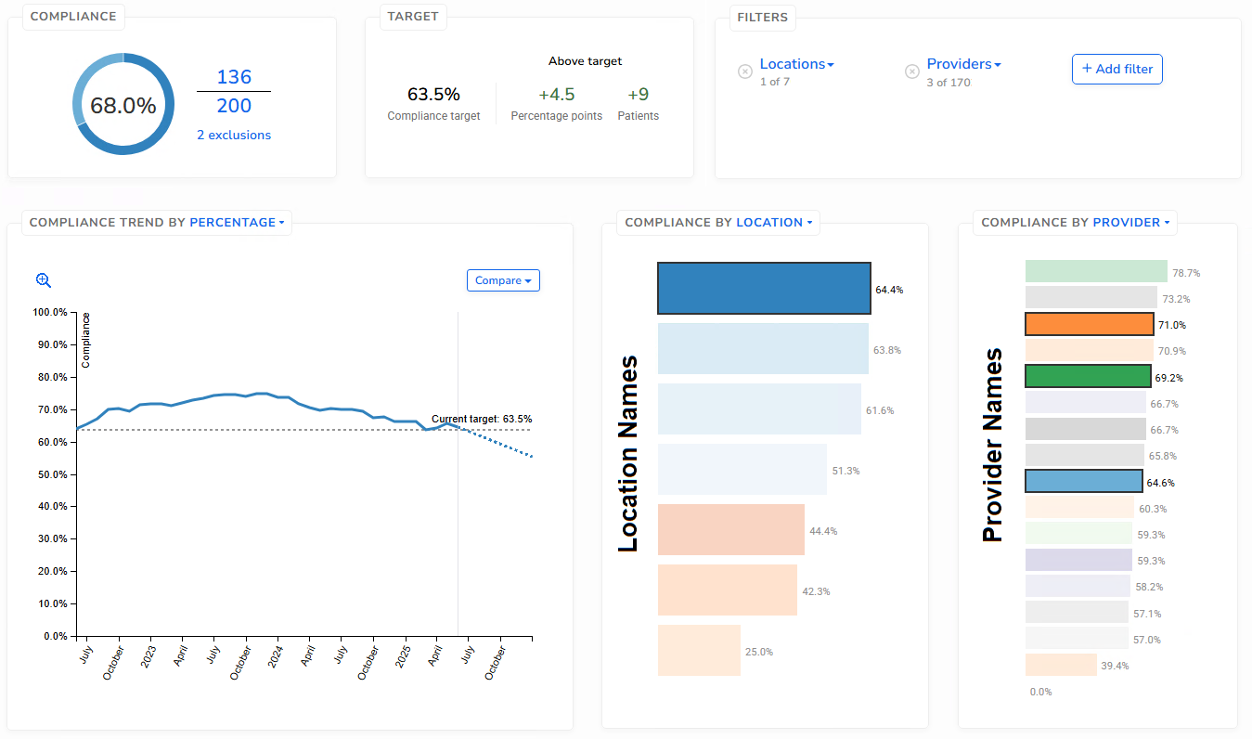
Display Patient Information From Measure Screens
In this example, we have drilled-down to the exact sub-population we want (i.e., patients of three providers at one location).
Now, we want to see who those patients are (i.e., the 200 patients in the denominator)
Click the numerator, denominator or exclusion numbers
(all are links)

Slide 25
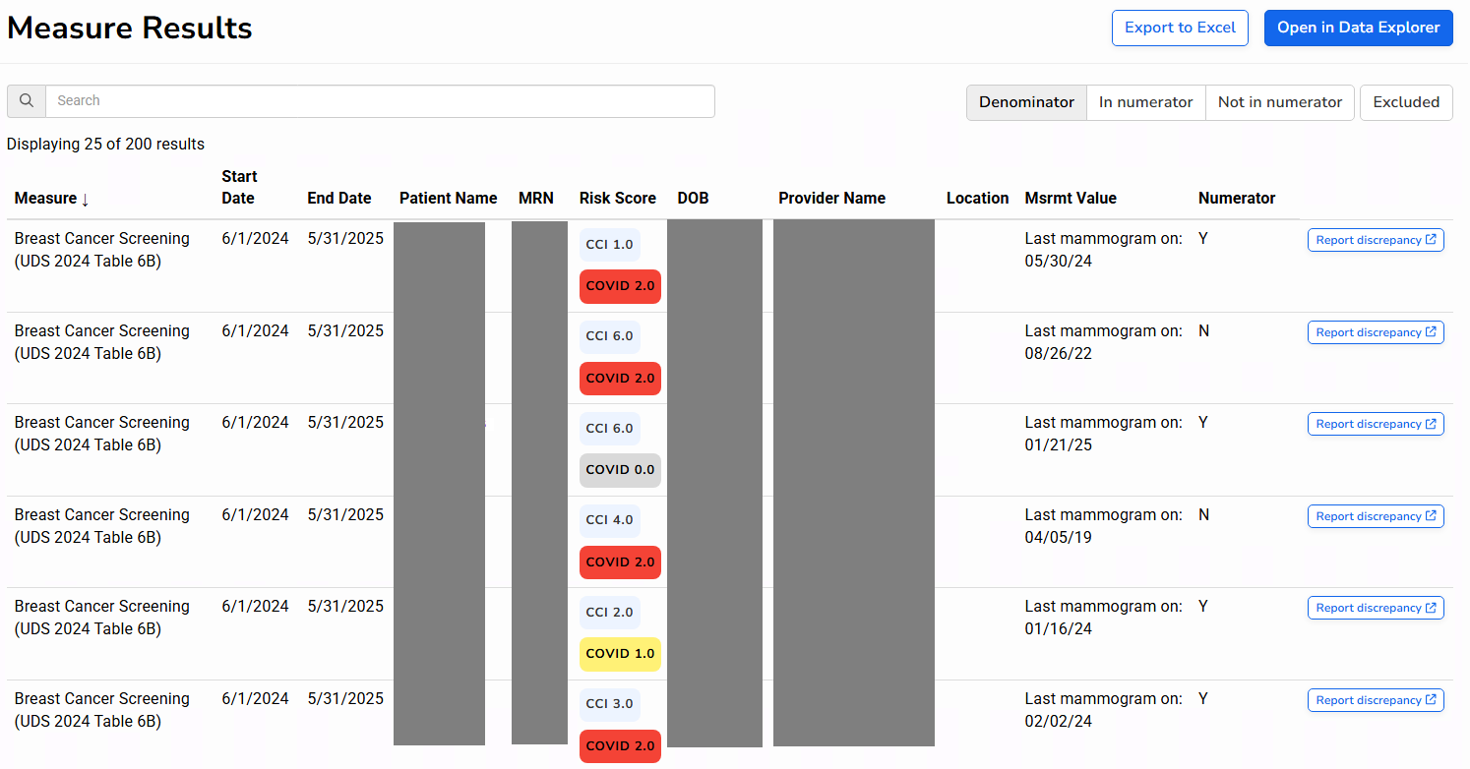
Follow Link to Patient Information Screen
Options to view data elsewhere
Measure results (value and numerator)
Patient identifiers

Slide 26
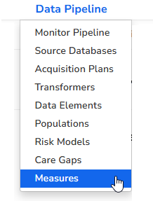
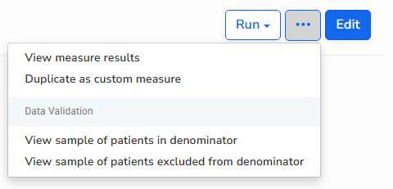

Data Validation
Generate random samples of patients (with proper permissions)
Any user can submit a Record Discrepancy. Look for the blue button on the measure results page showing individual patients. Promote this regularly among all users!
From the big list, choose a measure to validate
Compare data in QM to data in EHR for these patients

Slide 27
Overview of Quality Measure Results
Quality Assessment
Overall results and trend among all measure patients. These can be compared to measure goals.
View data for:
Present or past measurement periods
Standard subgroups and combinations of subgroups
Quality Improvement
View trends before/after performance improvement activities
Drill down to individual patients

Slide 28
Part B. Dashboards
Combine views from one or more Relevant Reports and Quality Measures to display a variety of information on one screen
Normally used to see summary data and trends
Generally, a dashboard is built around a single subject, for example, viewing different aspects of COVID immunizations or the breast cancer screening workflow
There are some standard dashboards built by Relevant and Aliados Health, but health centers can create their own

Slide 29
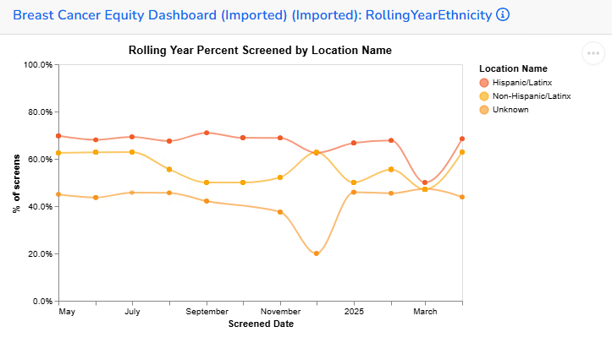
A Dashboard is Composed of “Tiles”
Example:

Slide 30
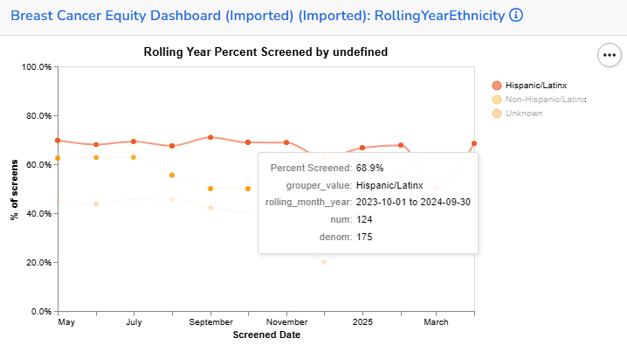
Hover Over Data Points, Click on Trend Lines or Click on the Legend

Slide 31
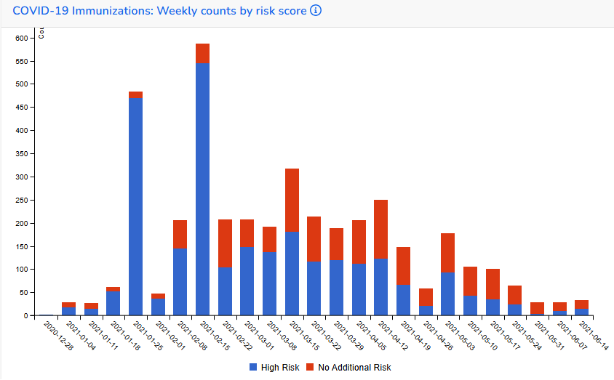
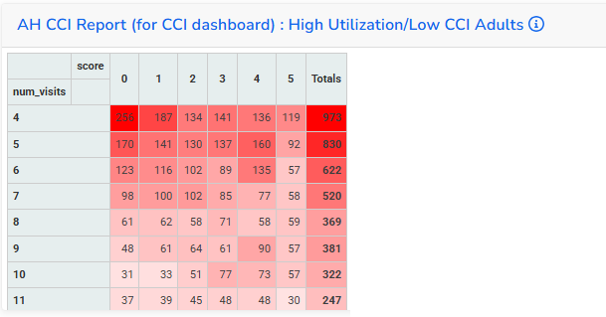
Other Kinds of Graphs/Tables Available
See Relevant Help file for more ideas

Slide 32
Part C. Reports
Reports are probably the most flexible and useful tool for obtaining data in Relevant
They are built using SQL language, but there are other options if you do not know SQL (we will see these on other slides)
Reports are useful for simple or very complex calculations
Once you design a report, it can be shared, accessed and used at any time
Commonly built with “measurement periods” which refer to something that is time-bound, like for example, patients seen in the past month, or another time frame the user chooses

Slide 33
Report Design
Any data that exists in Relevant (which also covers most of the data in the EHR, depending on what is being brought into Relevant in the nightly pipeline).
Therefore, if you can dream it, you can design it.
Reports can be used for Quality Assessment or Quality Improvement
The design is very flexible. A report can display detailed data that can then be summarized
Report results from several sources can be added to a dashboard

Slide 34
Report Components
Detailed data presented on a Data Grid
Define rows: can be unduplicated patients, visits, claims, etc. (depending on need)
Add columns that display data fields or calculations
Example on next slides: a report that displays unduplicated patients in rows who have diabetes and were seen for a UDS visit between two dates chosen by the user
Columns for last A1c between the two user dates, the patient’s race, and whether the patient was also diagnosed with hypertension

Slide 35
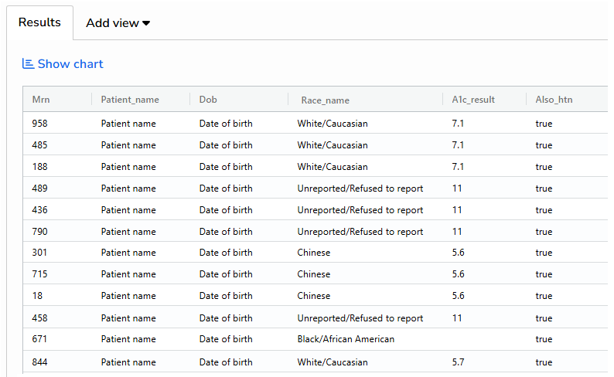
Example of a Data Grid

Slide 36
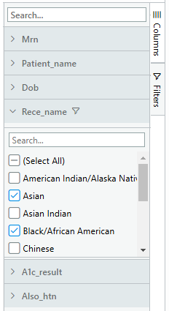
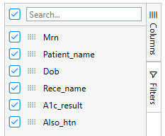
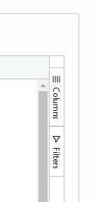
Data Grid Display Options
Row data can be sorted or filtered
Columns can be hidden or re-ordered
Click to open (Columns)
Click to open (Filters)
Click fields to open
Click/unclick values to filter
Unclick to hide
Drag to reorder (or, drag columns in the grid itself)

Slide 37
Report Summary Display
Summary tables or graphs on other tabs
Pivot tables based on the data
Vega-Lite Report View. Requires some technical know-how and patience to learn, but there are lots of different graph types, visualizations and color options to choose from
The primary purpose of a Pivot Table is to summarize and analyze data, allowing you to quickly extract meaningful insights from large datasets. It enables you to group, categorize, and aggregate data based on different fields, offering a flexible and interactive way to explore and present your data (reference: Google AI)

Slide 38
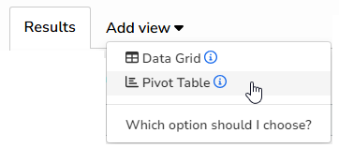
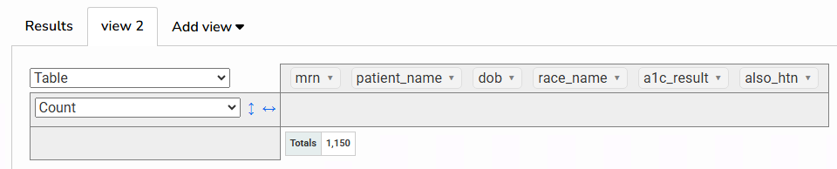
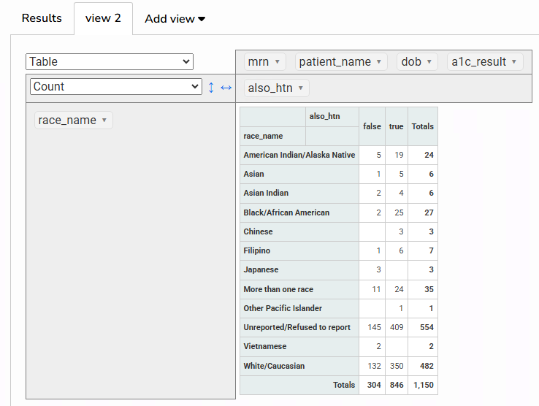
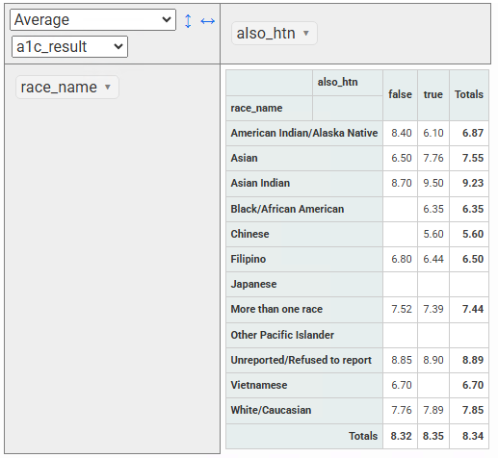
Pivot Table Example (From Report Results Screen)
Change values displayed in the cells
Drag fields to add them as summary rows and columns

Slide 39
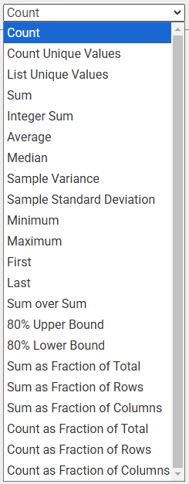
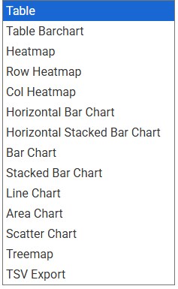

Data that can be displayed in the cells
Data visualizations available (besides a table)
NOT Vega-Lite
“Percentages” (in the row)

Slide 40
Part D. Visit Calendar
Originally (or primarily) to see visit counts and patients for providers, but also shows many other useful summaries
Can be used for a quick visit count or unique patient count based on the universe and filters you choose
The user decides the visit range dates (default is year-to-date)

Slide 41
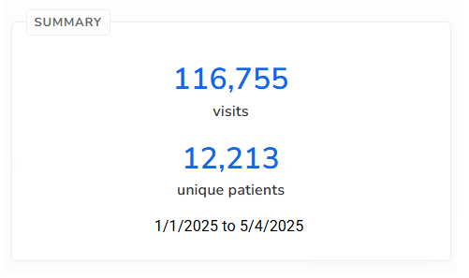
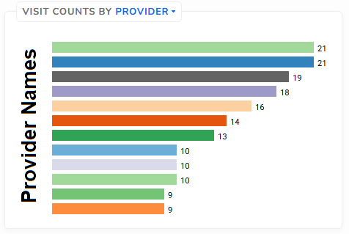
Components of the Visit Calendar
The main output is the number of visits and unique patients
There is also a breakdown display similar to the Quality Measure screen
Numbers for visits and unique patients are links to lists of individual visits and patients that can be exported to Excel or opened in Data Explorer

Slide 42
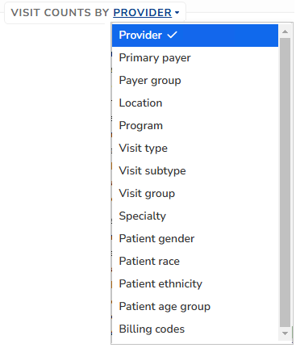
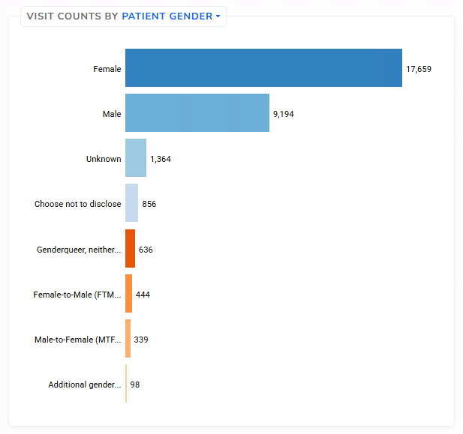
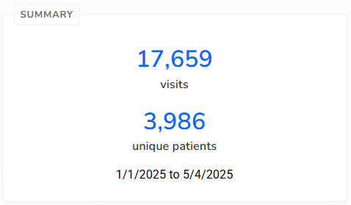
Breakdown Graph Display Options
Click on one or more bars to see the total visits and unduplicated patients
Example

Slide 43
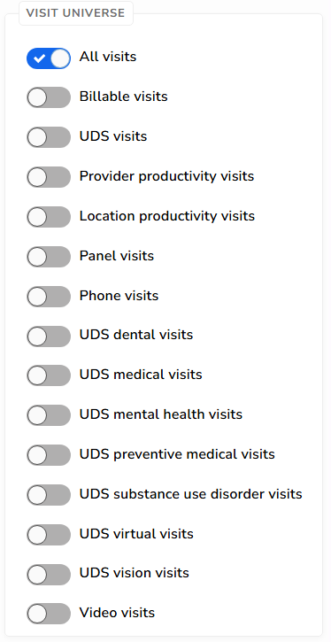
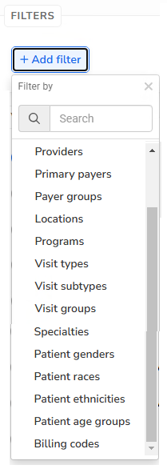
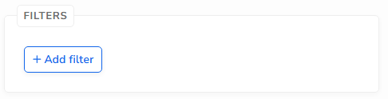
Add Filters and Visit Universe
Option to choose one kind of visit
Option to add filter(s)

Slide 44
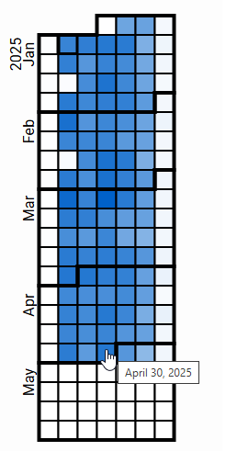
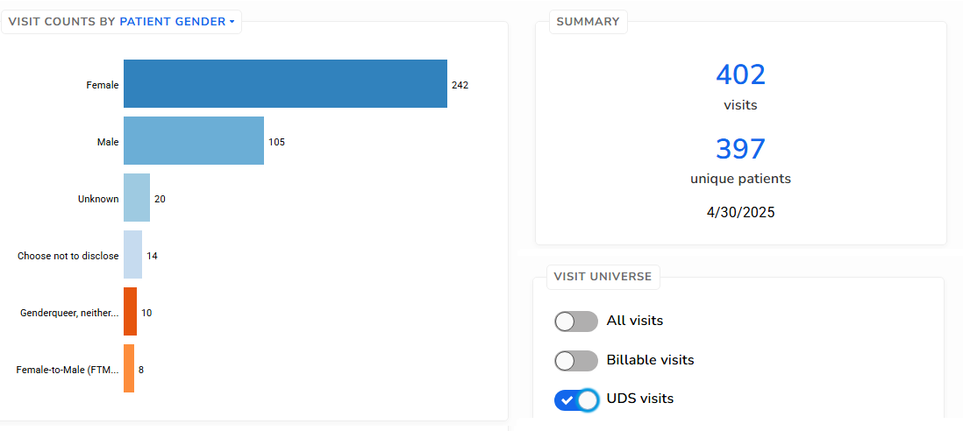

The Calendar in Visit Calendar
Click on a date to see visits on that day
Option: add a visit universe type. Example:

Slide 45
Quality Improvement (QI): Relevant Tools to Display Data for Individual Patients
Covering Three Tools

Slide 46
Relevant Tools for Individual Patients
QA/QI process steps from a previous slide
Once you get an idea of an area you would like to investigate from the summary tools, you may need to see more specific patient data
This is where you gather more specific data to generate ideas for performance improvement plans
You can also review patient data tied to a PDSA cycle
3. Make informed and evidence-based decisions about how and where to spend time, effort and resources, then measure the impact of the change

Slide 47
Part E. Reports (#2)
We covered reports already. They can be customized to your investigative needs
A report can show detailed data on patients, visits, claims, etc.
Columns can display any specific characteristics or variables you need for your investigation
Must be constructed using SQL

Slide 48
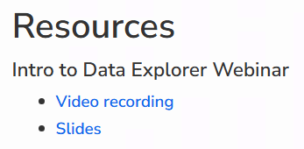
Part F. Data Explorer
Data Explorer allows users to build explorer reports without needing SQL code
Based on Data Elements that have already been mapped in your system
Not every EHR data field is available
Can be saved and then run at any time
See Relevant Help files and Resources

Slide 49
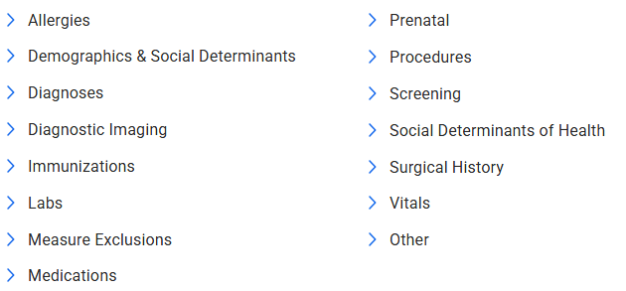
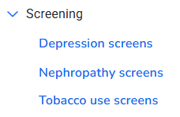
Start With a Base Element
Similar to a regular Relevant Report, you have to choose what is being displayed in the rows. What is the report based on?
Most common Base Elements are patients, visits and appointments, but you can also use specific items from these categories:
For example, you might want to list all depression screens

Slide 50
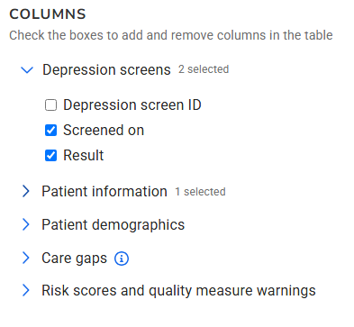

Add Columns to Display
Example using depression screens
Display options depending on the Base Element
Patient attributes. Examples
Will be discussed more in the session this afternoon

Slide 51


Add Filter(s)
Example using depression screens
For example, there are many ways to filter for the screening date range

Slide 52


Other Filters, Depending on Base Element
Patients
Visits

Slide 53

Part G. Population Explorer
No SQL coding needed
Displays a list of patients based on filters you select
Certain patient information is provided for everybody on the list. Example:

Slide 54


Select a Combination of Built-In Filters

Slide 55

Use And/Or Logic to Combine the Filters
For example, this query will display patients with:
Race equal to “Black/African American”
Age group either between “18 to 39” or “65 to 74” years
Primary Insurance Group equal to “Partnership Health Plan”

Slide 56

Session This Afternoon
Will cover how to use in the various tools we covered this morning with:
Populations
Risk Models
Care Gaps

Slide 57
Questions?

