Slide 1
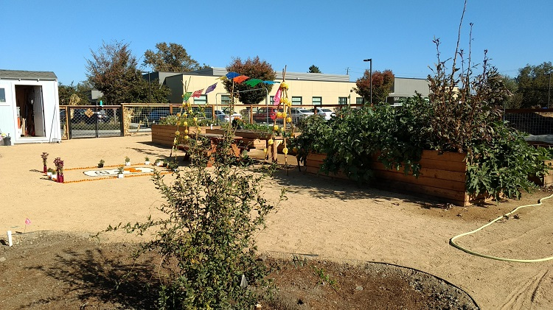
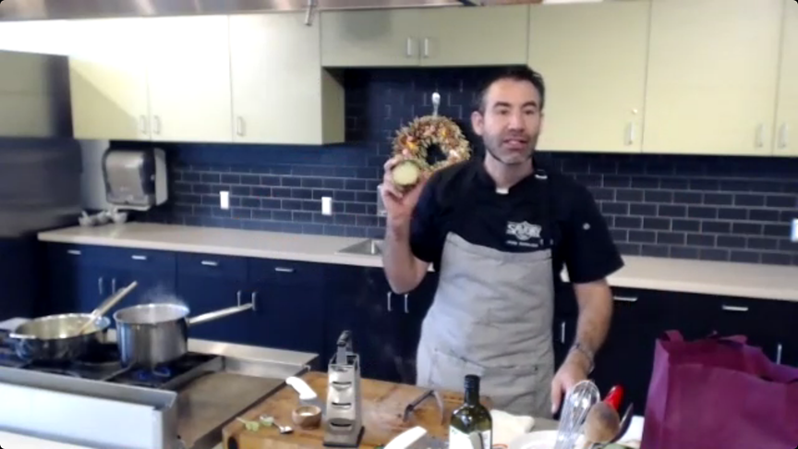
Food is Medicine
January 7, 2021
Redwood Community Health Coalition
Promising Practice
PROMISING PRACTICE OVERVIEW
ACTIONS TAKEN
CommuniCare Health Centers’ (CCHC) “Food is Medicine” initiatives integrate food with the delivery of clinical services. CCHC is located in Yolo County, where agricultural traditions run deep. Programs draw on unique community strengths to address patients’ mental and physical health needs while considering environmental justice.
Initiatives to date include the Garden and Outdoor Classroom, cooking classes, and produce distribution and prescriptions.
1. CommuniCare Garden and Outdoor Classroom:
Installed on 1/4 acre of land at Hansen Family Health Center in Woodland.
Classroom will host behavioral health, medical, and cooking classes (post-COVID); it is currently used for staff breaks.
Veggies grow in 12 raised beds; 14 fruit trees plus grape vines have been planted.
2. Cooking Classes:
CCHC implements Cooking Matters, an evidence-based curriculum that inspires healthy, affordable food choices.
After Stay-at-Home orders, CCHC created cooking videos for patients to stream.
Virtual cooking classes began in September and engage patients with gestational diabetes.
Participants pick up bagged ingredients from health center prior to class, then join virtual synchronous cooking class.
3. Food Distribution and Prescriptions
Produce first distributed in context of GMVs
Garden produce distributed in waiting room at Hansen Family Health Center
Produce prescription pilot underway in collaboration with Fiery Ginger Farm
AIM
Food is Medicine initiatives connect patients with healthy food and their community in order to address diet-related disease, food insecurity and social isolation.
DATA & EVALUATION
EMR data is used to track participation in Group Medical Visits (GMVs) and cooking classes. Qualitative in-depth interviews have been conducted regularly among GMV participants. A series of focus groups among monolingual Spanish speakers informed garden design elements. Qualitative data collection will soon expand to include participants in the cooking classes and produce prescription pilot.
CCHC has modified a validated pictorial Food Behavior Checklist to assess pre- and post-intervention changes in dietary intake. The tool also includes a brief assessment for social isolation, but results are not available due to COVID-related interruptions in programming.
Cooking class participants complete online surveys provided through Cooking Matters that capture information related to demographics and dietary behaviors pre- and post-intervention.
Garden harvests are weighed and tracked.
FARM TO PATIENT
CCHC began offering diabetes group medical visits in 2018; they featured produce which both incentivized patient participation and reinforced healthy eating messages. Some GMVs included food demonstrations, and snacks featuring the produce enabled participants to taste and go home with a recipe to recreate it.
In-person classes were paused when the COVID-19 Pandemic triggered Stay-at-Home orders. An urban farm in West Sacramento approached CommuniCare about piloting a produce prescription initiative among patients with diabetes in Fall 2020. Participants receive weekly deliveries of garden-grown produce for five weeks as an incentive for participating in diabetes education sessions. Satisfaction surveys and qualitative research will inform next steps for produce prescription activities.
Patients help themselves to pre-packed bags of garden-grown produce in the waiting room. Providers also distribute produce bags directly to patients.
Garden with ofrenda
Guest chef Juan Barajas leads a virtual cooking class
RESULTS TO DATE
Qualitative findings reveal patient satisfaction with produce distributions and the group visits, and most respondents reported consuming more fruits and vegetables. Focus group findings confirmed patient interest in accessing behavioral health services the garden.
While the pandemic has delayed some plans, it has highlighted the food security issues present in the community and propelled CCHC to prioritize this work. Through it all, CCHC has published a Food Programs page on their website and distributed 1,950 pounds of garden-grown produce to patients in 2020, reaching 1,200 (potentially duplicated) patients. The garden is used for socially-distanced events including a Día de los Muertos community ofrenda.
LESSONS LEARNED & NEXT STEPS
The garden represents CommuniCare’s long-term commitment to addressing the antecedents of poor health. Its maintenance will require sustained financial commitment and hard work. It is critical for patients to have ownership of the garden, and to that end CCHC has removed barriers to enable patient volunteering. Being adaptable during the pandemic has allowed the Food Programs to meet immediate needs.

