Slide 1
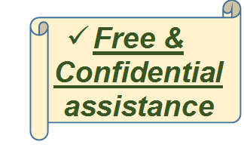
This Program is Supported by
Participating Agencies
Services for your Child
Research shows that all children should be checked for conditions that might interfere with learning and early brain development.
This brochure will tell you about how to access resources available to help your child be ready to learn.
Privacy Protection: Your information will not be released to enforce immigration laws. If you wish, home evaluations and services may be available.
Contact the Early Learning Institute “Navigator” for assistance: (707) 591-0170
May 2017

Slide 2
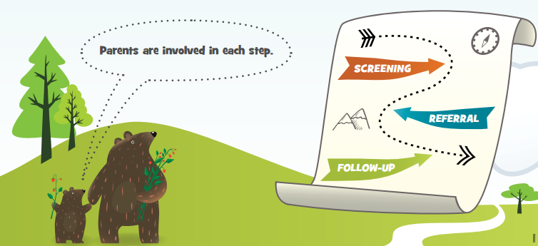
Birth until 3rd Birthday
Child is seen and, if needed, evaluated by specialist
Child is linked to eligible services & other free community resources
Parent tells Health Center about plan
Screening for all children at 9, 18 & 30 months
If a concern is identified → family is linked with navigator at Early Learning Institute (ELI)
3-5 year Olds
If no special services are needed → your child will
return to health center for regular well-child visits
Screening if parent or provider voices a concern during well-child visit
If further assessment is needed → information is shared with child’s school district*
* Parents can expect to be contacted by their school district within 15 days after a referral is received and school is in session.

